Slide 1
Fundamentals of Normal Metal and
Superconductor Electrodynamics
Steven M. Anlage
Center for Nanophysics and Advanced Materials
Physics Department
University of Maryland
College Park, MD 20742-4111 USA
anlage@umd.edu

Slide 2
Outline
High Frequency Electrodynamics of Superconductors
Experimental High Frequency Superconductivity
Further Reading

Slide 3
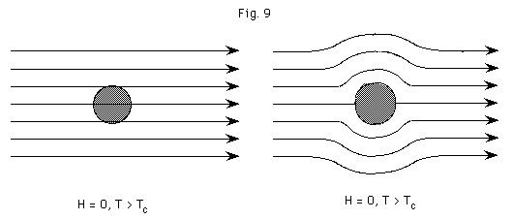
The Three Hallmarks of Superconductivity
Zero Resistance
Complete Diamagnetism
Macroscopic Quantum Effects
I
Flux Φ
V
T>T_{c}
T<T_{c}
DC Resistance
Magnetic Induction
0
T_{c}
0
Flux quantization Φ = nΦ₀
Josephson Effects
T_{c}
Temperature
Temperature

Slide 4
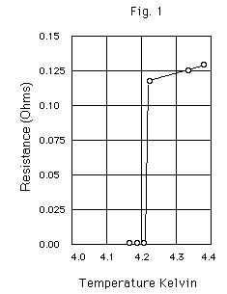
Zero Resistance
R = 0 only at ω = 0 (DC)
R > 0 for ω > 0
E
Quasiparticles
2Δ
The Kamerlingh Onnes resistance measurement of mercury. At 4.15K the resistance suddenly dropped to zero
Energy
Gap
0
Cooper Pairs

Slide 5
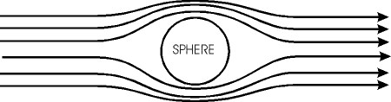
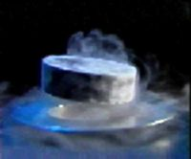

Perfect Diamagnetism
Magnetic Fields and Superconductors are not generally compatible
The Meissner Effect
Super-
conductor
T>T_{c}
T<T_{c}
λ(T)
λ
Spontaneous exclusion of magnetic flux
magnetic
penetration
depth
vacuum
superconductor
Β=0
λ
surface
screening
currents
λ(0)
T
T_{c}
λ is independent of frequency (ω < 2Δ)
The Yamanashi MLX01 MagLev
test vehicle achieved a speed of
361 mph (581 kph) in 2003

Slide 6
High Frequency Electrodynamics
of Superconductors
Why are Superconductors so Useful at High Frequencies?
Normal Metal Electrodynamics
The Two-Fluid Model
London Equations
BCS Electrodynamics
Nonlinear Surface Impedance

Slide 7
Why are Superconductors so Useful
at High Frequencies?
Low Losses:
Filters have low insertion loss ➔ Better S/N, filters can be made small
High Q ➔ Filters have steep skirts, good out-of-band rejection
NMR/MRI SC RF pickup coils ➔ x10 improvement in speed of spectrometer
Low Dispersion:
SC transmission lines can carry short pulses with little distortion
RSFQ logic pulses – 1 ps long, ~2 mV in amplitude:
Superconducting Transmission Lines
Kinetic
Inductance
L_{kin}
Geometrical
Inductance
L_{geo}
microstrip
(thickness t)
J
B
C
dielectric
E
ground
plane
propagating TEM wave
attenuation α ~ 0
L = L_{kin} + L_{geo} is frequency independent

Slide 8
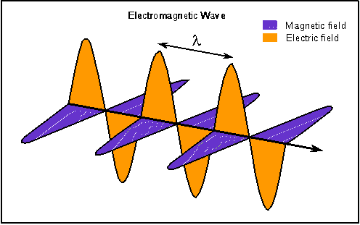
Normal Metal Electrodynamics
Consider a TEM wave incident normally on a metal half-space
Metal
Constitutive equations for metal
Continuity Equation
Ohm’s law
(local limit)
LIH media
~ (1 μΩcm)(8.85 x 10⁻¹² F/m)
~ 10⁻¹⁹ s
So
Hence we can ignore free charge in the conductor
In reality free charge dissipates at the collision time scale, τ_{c} ~ 10⁻¹⁴ – 10⁻¹² s

Slide 9
Normal Metal Electrodynamics
Take the curl of the curl equations
These are wave equations with a μσ dissipative term
Ansatz
with
One finds
The waves oscillate and decay as they enter the metal
Define the skin depth
For a metal with ρ = 1 μΩ-cm at 2.5 GHz,

Slide 10
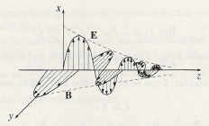
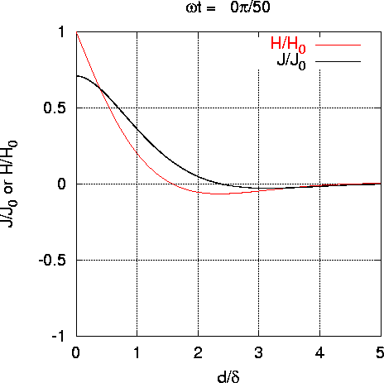
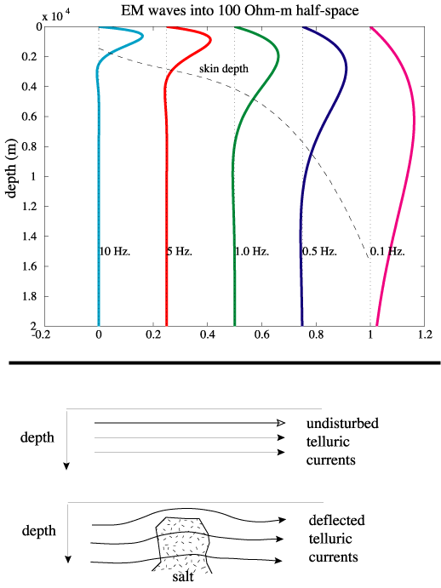
Normal Metal Electrodynamics
Griffiths, Electrodynamics
Phase difference between E, B:
Animated version

Slide 11
Electrodynamics of Superconductors
in the Meissner State
E
Normal Fluid channel
σ_{n}
Quasiparticles
(Normal Fluid)
≈
2Δ
Energy
Gap
L_{s}
0
Cooper Pairs
(Super Fluid)
Superfluid channel
Current-carrying superconductor
J_{s}
J = J_{s} + J_{n}
J
J_{n}
n = n_{s}(T) + n_{n}(T)
n_{s}(T)
n_{n}(T)
J = σ E
σ_{n} = n_{n}e²τ/m
σ₂ = n_{s}e²/mω
n
n_{n} = number of QPs
n_{s} = number of SC electrons
τ = QP momentum relaxation time
m = carrier mass
ω = frequency
σ = σ_{n} – i σ₂
0
T
T_{c}

Slide 12
Superconductor Electrodynamics
T = 0
ideal s-wave
σ₁(ω)
σ₂(ω) ~ 1/ω
σ = σ₁−iσ₂
Normal State (T > T_{c})
(Drude Model)
σ₂(ω)
n_{s}(T)
(π n_{s}e²/m)δ(ω)
σ₁(ω)
0
T
0
T_{c}
Superfluid density
λ² ~ m/n_{s}
~ 1/ω_{ps}²
ω
0
0
1/τ
“binding energy” of Cooper pair (100 GHz ~ few THz)
Surface Impedance (ω > 0)
Normal State
Superconducting State (ω < 2Δ)
Penetration depth
λ(0) ~ 20 – 200 nm
Finite-temperature: X_{s}(T) = ωL = ωμ₀λ(T) → ∞ as T →T_{c} (and ω_{ps}(T) → 0)
Narrow wire or thin film of thickness t : L(T) = μ₀λ(T) coth(t/λ(T)) → μ₀ λ²(T)/t
Kinetic Inductance

Slide 13
Surface Impedance
y
H
E
x
J
conductor
-z
Local Limit
Surface Resistance R_{s}: Measure of Ohmic power dissipation
R_{s}
Surface Reactance X_{s}: Measure of stored energy per period
X_{s}
L_{geo}
L_{kinetic}
X_{s} = ωL_{s} = ωμλ

Slide 14
Two-Fluid Surface Impedance
Normal Fluid channel
σ_{n}
L_{s}
R_{n} ~ ω^{1/2}
Superfluid channel
Because R_{s} ~ ω²:
The advantage of HTS over Cu
diminishes with increasing frequency
R_{s} crossover at f ~ 100 GHz at 77 K
R_{s} ~ ω²
M. Hein, Wuppertal

Slide 15
The London Equations
Newton’s 2nd Law for
a charge carrier
τ = momentum relaxation time
J_{s} = n_{s} e v_{s}
Superconductor:
1/τ ➔ 0
1st London Equation
1st London Eq. and
(Faraday) yield:
London
surmise
2nd London Equation
These equations yield the Meissner screening
vacuum
superconductor
λ_{L}
λ_{L} is frequency independent (ω < 2Δ)
λ_{L} ~ 20 – 200 nm
Notes:
Starting with the second London Equation, use Ampere’s Law Curl B ~ J, you get the London screening equation for H.

Slide 16
The London Equations continued
Normal metal
Superconductor
E is the source of J_{n}
E=0: J_{s} goes on forever
Lenz’s Law
B is the source of J_{s},
spontaneous flux
exclusion
1st London Equation ➔ E is required to maintain an ac current in a SC
Cooper pair has finite inertia ➔ QPs are accelerated and dissipation occurs

Slide 17
BCS Microwave Electrodynamics
Low Microwave Dissipation
Full energy gap → R_{s} can be made arbitrarily small
for T < T_{c}/3 in a
fully-gapped SC
Δ_{s}
k_{y}
Filled
Fermi
Sea
k_{x}
R_{s,residual} ~ 10⁻⁹ Ω at 1.5 GHz in Nb
node
HTS materials have nodes in
the energy gap. This leads
to power-law behavior of
λ(T) and R_{s}(T) and residual losses
k_{y}
Δ_{d}
Filled
Fermi
Sea
k_{x}
R_{s,residual} ~ 10⁻⁵ Ω at 10 GHz in YBa₂Cu₃O_{7-δ}
M. Hein, Wuppertal

Slide 18
Nonlinear Surface Impedance of Superconductors
The surface resistance and reactance values depend on the rf current
level flowing in the superconductor
YBa₂Cu₃O_{7-δ} Thin Film
Made by Pulsed Laser Deposition
and sputtering
19 GHz
Similar results for X_{s}(B_{s})
Data from M. Hein, Wuppertal

Slide 19
How can Superconductors become Nonlinear?
Granularity
Josephson
weak links
Small ξ ~ grain boundary thickness
JJs have
a strongly
nonlinear
impedance
Superconducting
grains
McDonald + Clem
PRB 56, 14 723 (1997)
Edge-Current Buildup
+ Vortex Entry and Flow
Scanning Laser Microscope image
YBCO strip at T = 79 K
f = 5.285 GHz, Laser Spot Size = 1 μm
See Appl. Phys. Lett. 88, 212503 (2006)
J_{rf}² (a.u.)
Heating
Microstrip (Longitudinal view)
Intrinsic Nonlinear Meissner Effect
rf currents cause de-pairing – convert superfluid into normal fluid
J_{NL}(T) calculated by theory (Dahm+Scalapino)
Nonlinearities are generally strongest near T_{c} and weaken at lower temperatures

Slide 20
How to Model Superconducting Nonlinearity?
(1) Taylor series expansion of nonlinear I-V curve (Z. Y. Shen)
= 0 if I(-V) = -I(V)
I
V
1/R linear term
3rd order term dominates
V = V₀ sin(ωt) input yields ~ V₀³ sin(3ωt) + … output
(2) Nonlinear transmission line model (Dahm and Scalapino)
I
3rd harmonics and 3rd order IMD result
R
L
V
C
L and R are nonlinear:
additional terms

Slide 21
Experimental High Frequency Superconductivity
Resonators
Cavity Perturbation
Measurements of Nonlinearity
Topics of Current Interest
Microwave Microscopy

Slide 22
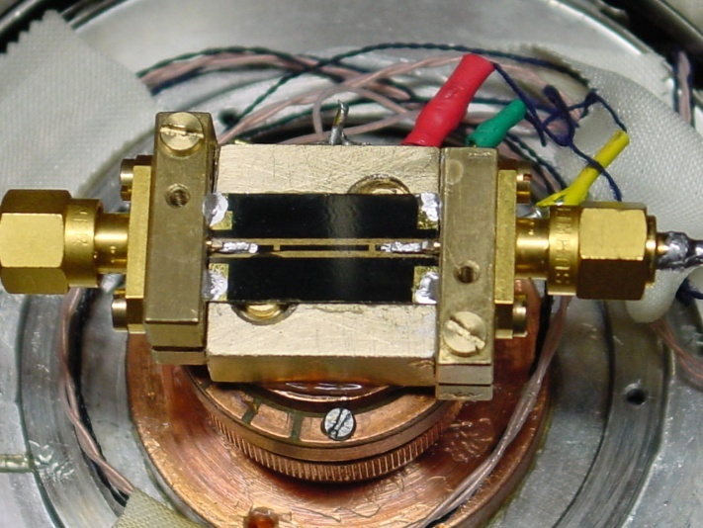
Resonators
… the building block of superconducting applications …
Microwave surface impedance measurements
Cavity Quantum Electrodynamics of Qubits
Superconducting RF Accelerators
Metamaterials (μ_{eff} < 0 ‘atoms’)
etc.
co-planar waveguide resonator
P_{out}
P_{in}
Port 2
Port 1
|S₂₁(f)|²
resonator
transmission
f₀
f

Slide 23
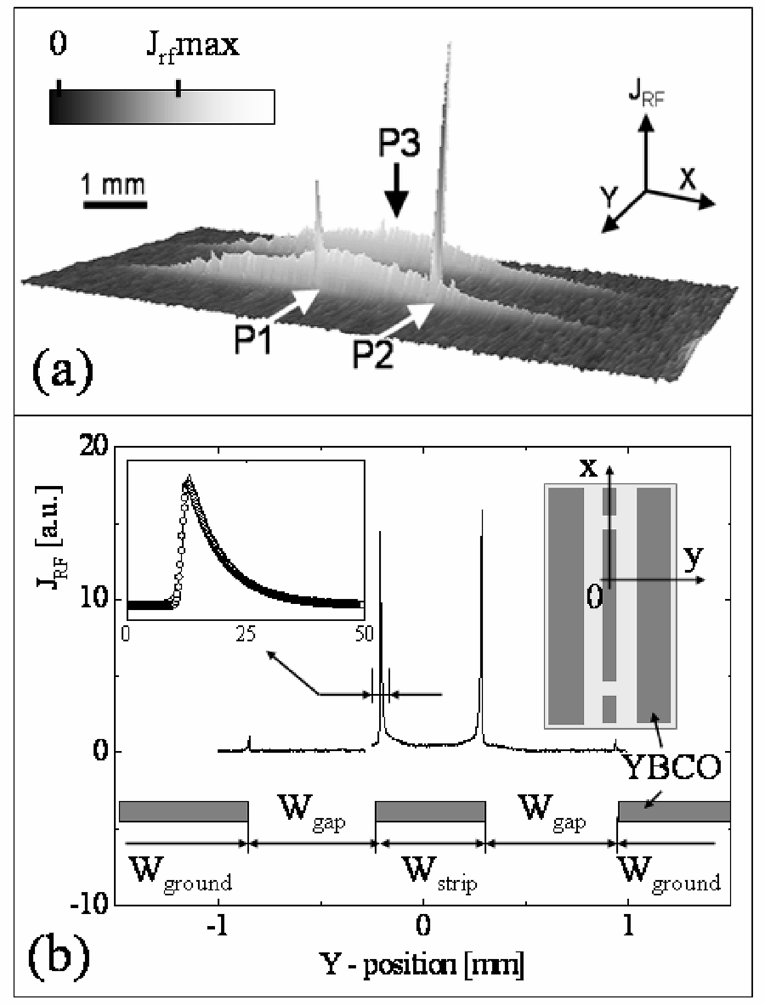
Resonators (continued)
YBCO/LaAlO₃
CPW Resonator
Excited in Fundamental Mode
Imaged by Laser Scanning Microscopy*
1 x 8 mm scan
T = 79 K
P = - 10 dBm
f = 5.285 GHz
W_{strip} = 500 μm
*A. P. Zhuravel, et al., J. Supercond. 19, 625 (2006)

Slide 24
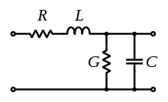
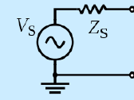
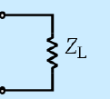
Transmission Line Resonators
Transmission Line Model
Transmission Line
Unit Cell
Transmission Line Resonator Model
C_{coupling}
C_{coupling}

Slide 25
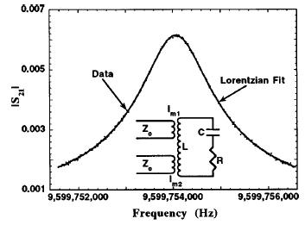

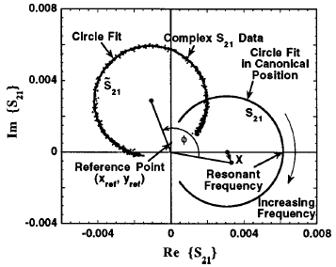

Resonators (continued)

Slide 26
Cavity Perturbation
Objective: determine R_{s}, X_{s} (or σ₁, σ₂) from f₀ and Q measurements
of a resonant cavity containing the sample of interest
Input
Output
transmission
T₁
T₂
~ microwave
wavelength
λ
B
δf
δf’
Microwave
Resonator
Sample at
Temperature T
frequency
f₀
f₀’
Quality Factor
Δf = f₀’ – f₀ ∝ Δ(Stored Energy)
Δ(1/2Q) ∝ Δ(Dissipated Energy)
Cavity perturbation means Δf << f₀
Γ is the sample/cavity geometry factor

Slide 27
Measurement of Nonlinearities
Intermodulation is a practical problem
Nonlinear (i. e., signal strength dependent) microwave response
induces undesirable signals within the passband by intermodulation.
P_{out} (dB)
3rd-order
intercept
Point (TOI)
20
15
10
linear
ω₁
2ω₁ - ω₂, 2ω₂ - ω₁
Bandwidth of
passband
5
signal
P_{in} (dB)
–15
–10
–5
5
10
15
–5
P_{in}
SC
Device
P_{out}
–10
frequency
–15
2f₁-f₂ f₁ f₂ 2f₂-f₁ 2f₁
–20
Intermodulation harmonic generation
–25
M. Hein, Wuppertal

Slide 28
Topics of Current Interest
In Microwave Superconductivity Research
Identifying and eliminating the microscopic sources of extrinsic nonlinearity
Increase device yield
Allows further miniaturization of devices
Allow development of ILC Nb cavities with BCS-limited properties
Superconducting Metamaterials: J. Opt. 13, 024001 (2011)
Low-loss, compact, tunable metamaterial ‘atoms’
Controlling de-coherence in superconducting qubits
Identify and eliminate two-level systems in dielectrics

Slide 29
Microwave Microscopy of Superconductors
Use near-field optics techniques to obtain super-resolution images of:
1) Materials Properties: Nonlinear response
2) RF fields in operating devices
500Å
YBCO film
200μm
loop probe
Phys. Rev. B 72, 024527 (2005)
J
SrTiO₃
See:
2MY-08
5MZ-03
30° misorientation
Bi-crystal grain boundary
Laser Scanning Microscopy
Image J_{rf}²(x,y) in an operating
superconducting microwave device
Image J_{IMD}
20 μm
reflectance
J_{rf}²
20 μm
IEEE Trans. Appl. Supercond. 17, 902 (2007)

Slide 30
Superconducting Metamaterials
Build artificial ‘atoms’ with tailored electric and magnetic response
An array of these sub-wavelength ‘atoms’ are described by ε_{eff}, μ_{eff}

Slide 31
Negative Index Passband with a
Superconducting All-Nb Metamaterial
Increasing temperature
See:
3EZ-01
4EB-05
5EPG-05
Transmission
Appl. Phys. Lett. 87, 034102 (2005)
arXiv:1004.3226

Slide 32
References and Further Reading
Z. Y. Shen, “High-Temperature Superconducting Microwave Circuits,”
Artech House, Boston, 1994.
M. J. Lancaster, “Passive Microwave Device Applications,”
Cambridge University Press, Cambridge, 1997.
M. A. Hein, “HTS Thin Films at Microwave Frequencies,”
Springer Tracts of Modern Physics 155, Springer, Berlin, 1999.
“Microwave Superconductivity,”
NATO- ASI series, ed. by H. Weinstock and M. Nisenoff, Kluwer, 2001.
T. VanDuzer and C. W. Turner, “Principles of Superconductive Devices and Circuits,”
Elsevier, 1981.
T. P. Orlando and K. A. Delin, “Fundamentals of Applied Superconductivity,”
Addison-Wesley, 1991.
R. E. Matick, “Transmission Lines for Digital and Communication Networks,”
IEEE Press, 1995; Chapter 6.
Alan M. Portis, “Electrodynamcis of High-Temperature Superconductors,”
World Scientific, Singapore, 1993.

Slide 33
Superconductivity Links
Wikipedia article on Superconductivity
http://en.wikipedia.org/wiki/Superconductivity
Superconductor Information for the Beginner
http://www.superconductors.org/
Gallery of Abrikosov Vortex Lattices
http://www.fys.uio.no/super/vortex/
Graduate course on Superconductivity (Anlage) http://www.physics.umd.edu/courses/Phys798S/anlage/Phys798SAnlageSpring06/index.html
YouTube videos of Superconductivity (Alfred Leitner)
http://www.youtube.com/watch?v=nLWUtUZvOP8

Slide 34
Please Ask Questions!

